Slide 1
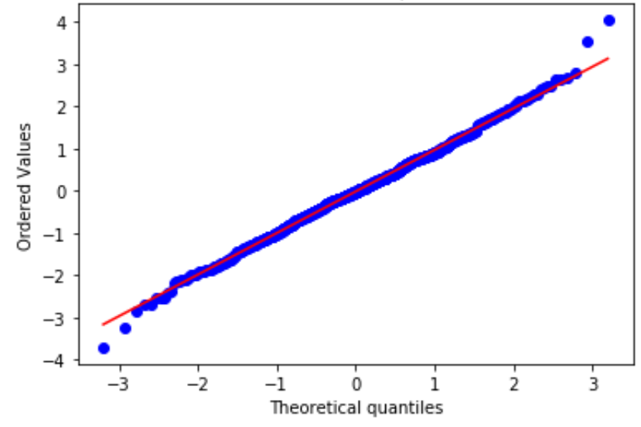
Quantile-Quantile plot
Find the value x in the sample that gives the same observed percentile
Calculate the corresponding percentile given the CDF
For a given value of x

Slide 2
Quantile-Quantile plot

